Slide 1
R-02 To Resolve VCCIO Boot-up Failure
NVL-S RVP
Required Rework Document

Slide 2
R-02
To Resolve VCCIO Boot-up Failure
Change Log | 2025 WW30
Description | This rework is to fine-tune the VCC sequence of the VCCIO VR
Impact | The V5A will follow V5DSW to turn on without MOSFET control. The total Power consumption will be higher(~2mW) during DSx.
Rework Involved | SMD resistor
SKUs | S-031 FAB1
Contacts | Chen, Ellen ; Wang, Ivan B
HSD Link | N/A
Collateral Link | N/A
SW Dependency | N/A

Slide 3
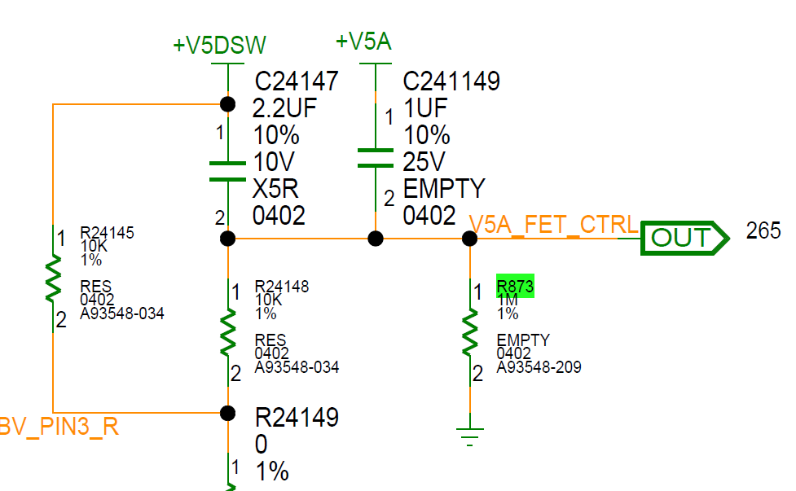
NVL-S RVP S-031 Top

Slide 4
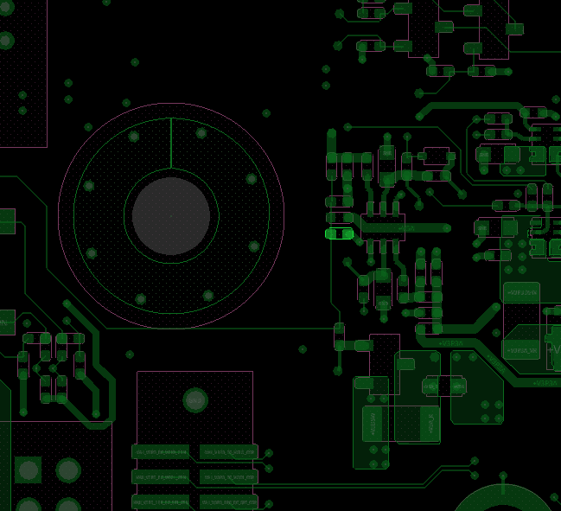
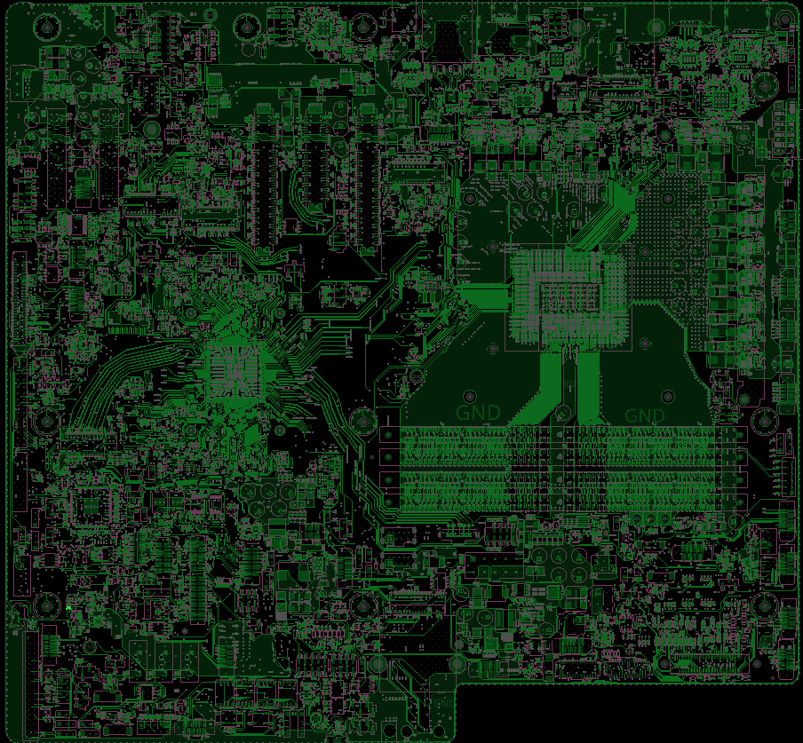
NVL-S RVP S-031
Step 1 of 1
Action | REFDES | Description
STUFF | R873 | RES D,0402,1.00 kOHM,1.00%,1/16W
R873
TOP

Slide 5
NVL-S RVP S-031
R-02 To Resolve VCCIO Boot-up Failure
Rework Summary
Action | Item | REFDES | Current IPN | Description | New IPN | Description
STUFF | RESISTOR | R873 | NA | NA | A93548-023 | RES D,0402,1.00 kOHM,1.00%,1/16W

